Slide 1
Capstone Project - The Battle of Neighborhoods
Presentation

Slide 2
Introduction
The objective of this project was to create a localized model that tries to predict what type of venue would be popular based on its geographical coordinates

Slide 3
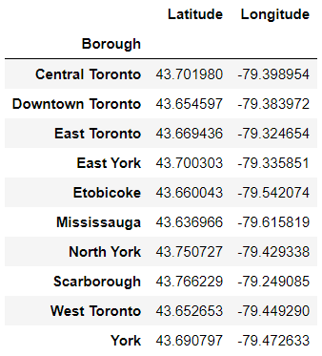
Data
Geographical coordinates for the different neighborhoods in the test city Toronto
Geographical coordinates of the currently most popular venues in the city’s boroughs

Slide 4
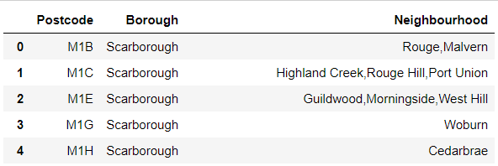
Methodology:
Loaded postal code per neighborhood into a dataste and preprocessed it

Slide 5
Loaded data with coordenates for each postal code into a dataset
Preprocessed the dataset and appended it to the neighborhood one
Grouped postal codes by borough and determined coordinates based on averages

Slide 6
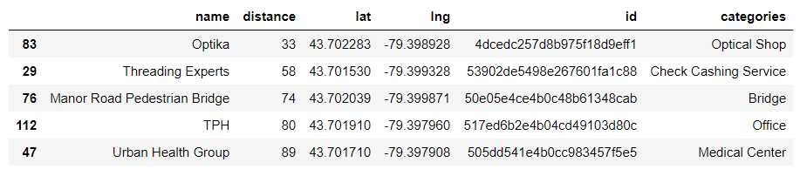
Run a query for popular venues in each borough coordinates using Foursquared API
Preprocessed the data into a table for each borough

Slide 7
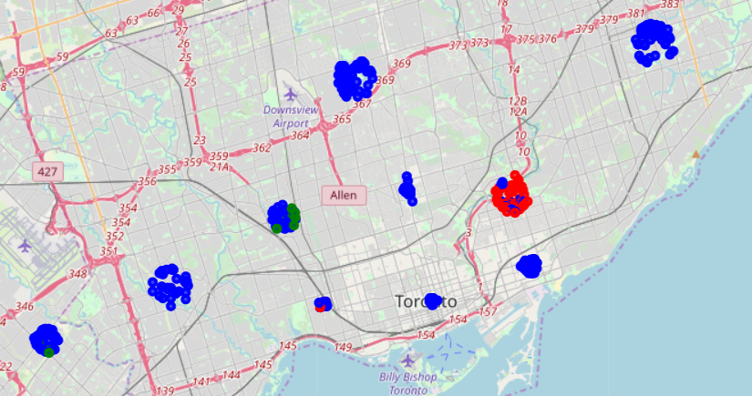
Grouped the categories based on text search
Ploted the groups using folium

Slide 8
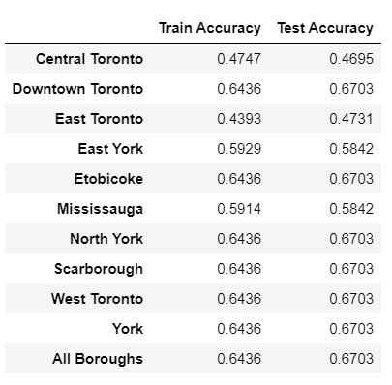
Results
Multinomial Logistic Regression with a softmax function was used to build a model for each borough
Models were trained and their accuracy evaluated

